Slide 1
German Tourism Knowledge Graph – Hosting & External Sources
Penz Manuel – Rasmusen Sven – Zaric Marko

Slide 2
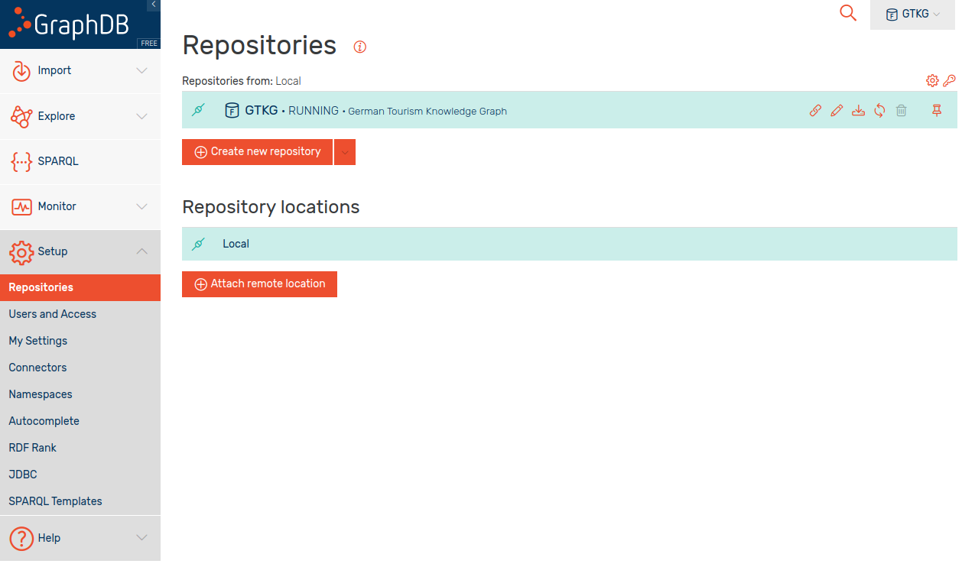
Hosting
Add new repository

Slide 3
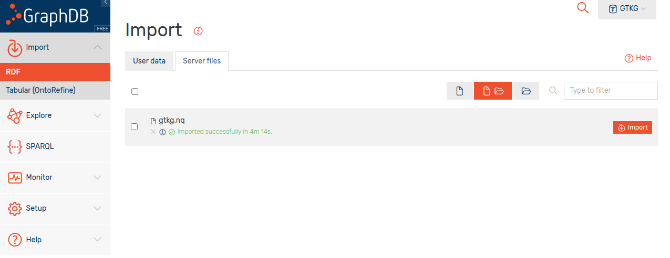
Hosting
Import RDF as „Server files“
User data limited to 200MB

Slide 4
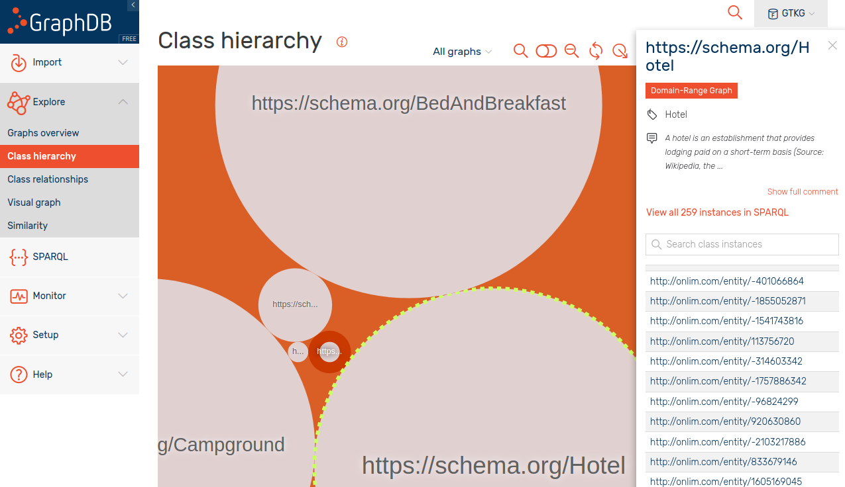
Hosting

Slide 5
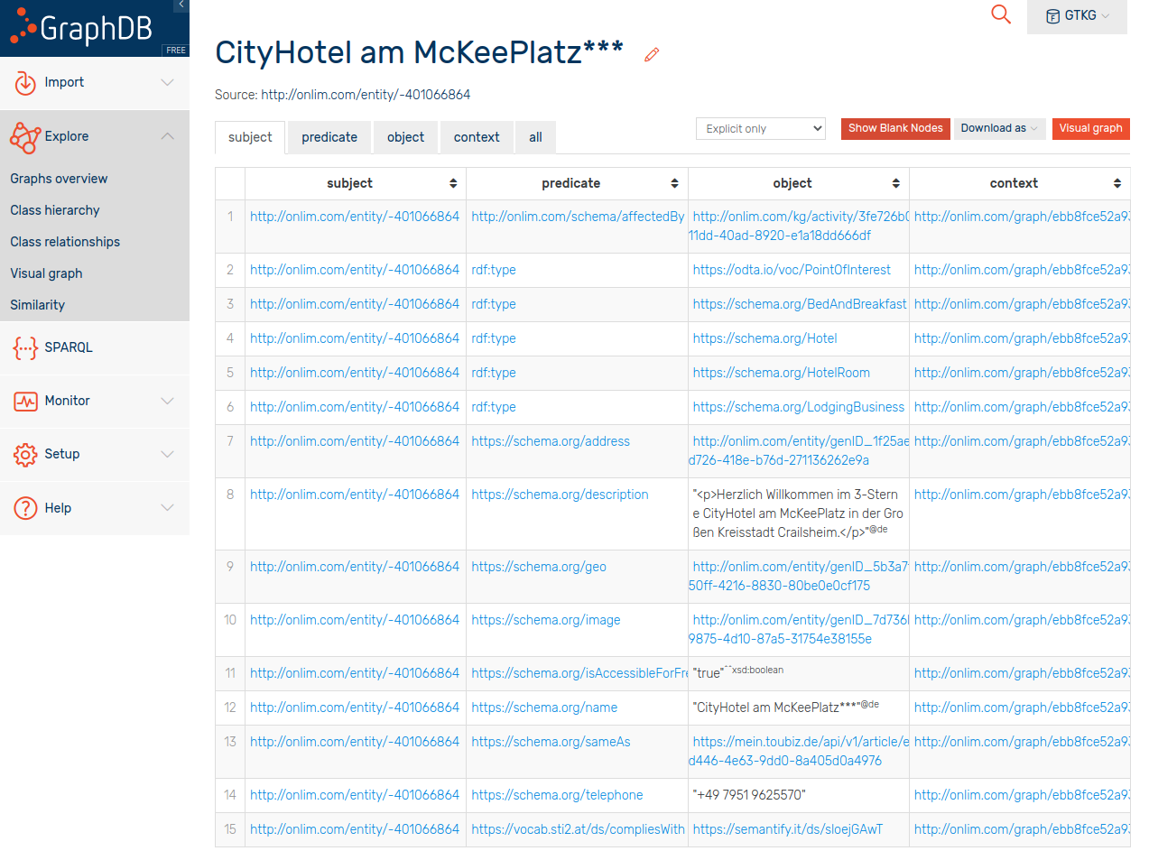
Hosting
Properties:
address
description
geo
image
IsAccessibleForFree
name
sameAs
telephone
compliesWith
Missing Properties:
rating
reviews

Slide 6
External Sources
www.booking.com
API:
Guest Review API - https://connect.booking.com/user_guide/site/en-US/review-api/
Offers:
Guest reviews
www.tripadvisor.com
API:
Content API - https://developer-tripadvisor.com/content-api/
Offers:
Location ID, name, address, latitude & longitude
Read reviews link, write-a-review link
Overall rating, ranking, subratings, awards, the number of reviews the rating is based on, rating bubbles image
Price level symbol, accommodation category/subcategory, attraction type, restaurant cuisine(s)

Slide 7
External Sources
www.govdata.de
SPARQL Endpoint available!
Offers:
Various statistical data collections regarding hotels / tourism
Google Maps API
API:
Places API (Nearby businesses, customer reviews, etc.)
Geocoding API (longitude, latitude)
JSON data

Slide 8
External Sources
www.wikidata.org
SPARQL Endpoint available!
Easy to learn how to query with SPARQL
Offers:
JSON, CSV, and TSV data
www.dbpedia.org
SPARQL Endpoint available!
Offers:
JSON, RDF, CSV, and many more

Slide 9


